Slide 1

INDUSTRIAL TRAINING KIT • BATCH 2026
Project 3: Enterprise
Random Password Generator
Architecting Secure Credential Systems with Python's Standard Library
Presented by Alina Mehmood
Python Developer Track • Powered by DecodeLabs
www.decodelabs.tech | Greater Lucknow, India

Slide 2

Welcome to the Team
Stepping into the role of a Python Developer at DecodeLabs
Project 3 is the security phase of the training track:
The Random Password Generator.
This is not simply about producing “random characters” — it is about Library Integration and String Manipulation.
Before building advanced encryption software, interns must master importing Python’s built-in random and string modules to generate non-predictable, secure data — bridging the gap between basic coding and functional security tooling.
Mission Objective
Design a digital shield that protects user accounts with absolute precision — through pure programmatic logic.
DecodeLabs | Project 3 | Random Password Generator
2

Slide 3



Guidelines: Qualification Criteria
Earn Your Badge
Requirement
Complete Project 3 to unlock other project tracks for next week.
Standard
All submitted projects must be verified for code quality and correctness.
Mandatory
Project 3 is the definitive milestone for mastering the security domain.
DecodeLabs | Project 3 | Random Password Generator
3

Slide 4


Project Goal & Key Skills
Goal
Write a tool that asks the user for a password length (e.g., 8 characters) and generates a random, complex password using letters, digits, and symbols.
Key Skill
Why It Matters
Importing Modules
(import random, import string, import secrets)
String Manipulation
Teaches interns how to use Python’s built-in libraries to solve real-world security problems — the foundation of professional, maintainable backend engineering.
DecodeLabs | Project 3 | Random Password Generator
4

Slide 5
From Isolated Scripts to Enterprise Systems
This project is the gatekeeper to advanced backend development.
Junior Scripting
Enterprise Architecture
Custom, one-off logic for every problem
Verified, standard-library components
Manually typed character arrays
string module for locale-independent sets
Unpredictable pseudo-random values
secrets module for cryptographic security
Quadratic-time string concatenation
Linear-time .join() accumulation
No validation of user input
Rigorous input validation & error handling
DecodeLabs | Project 3 | Random Password Generator
5

Slide 6


The Input – Process – Output Scaffold
Complex workflows become manageable when broken into three distinct phases.
Input
Process
Output
Capture environmental requirements and validate user data.
Run computational transformations through the core logic engine.
Deliver a secure, high-integrity password to the user.
DecodeLabs | Project 3 | Random Password Generator
6

Slide 7
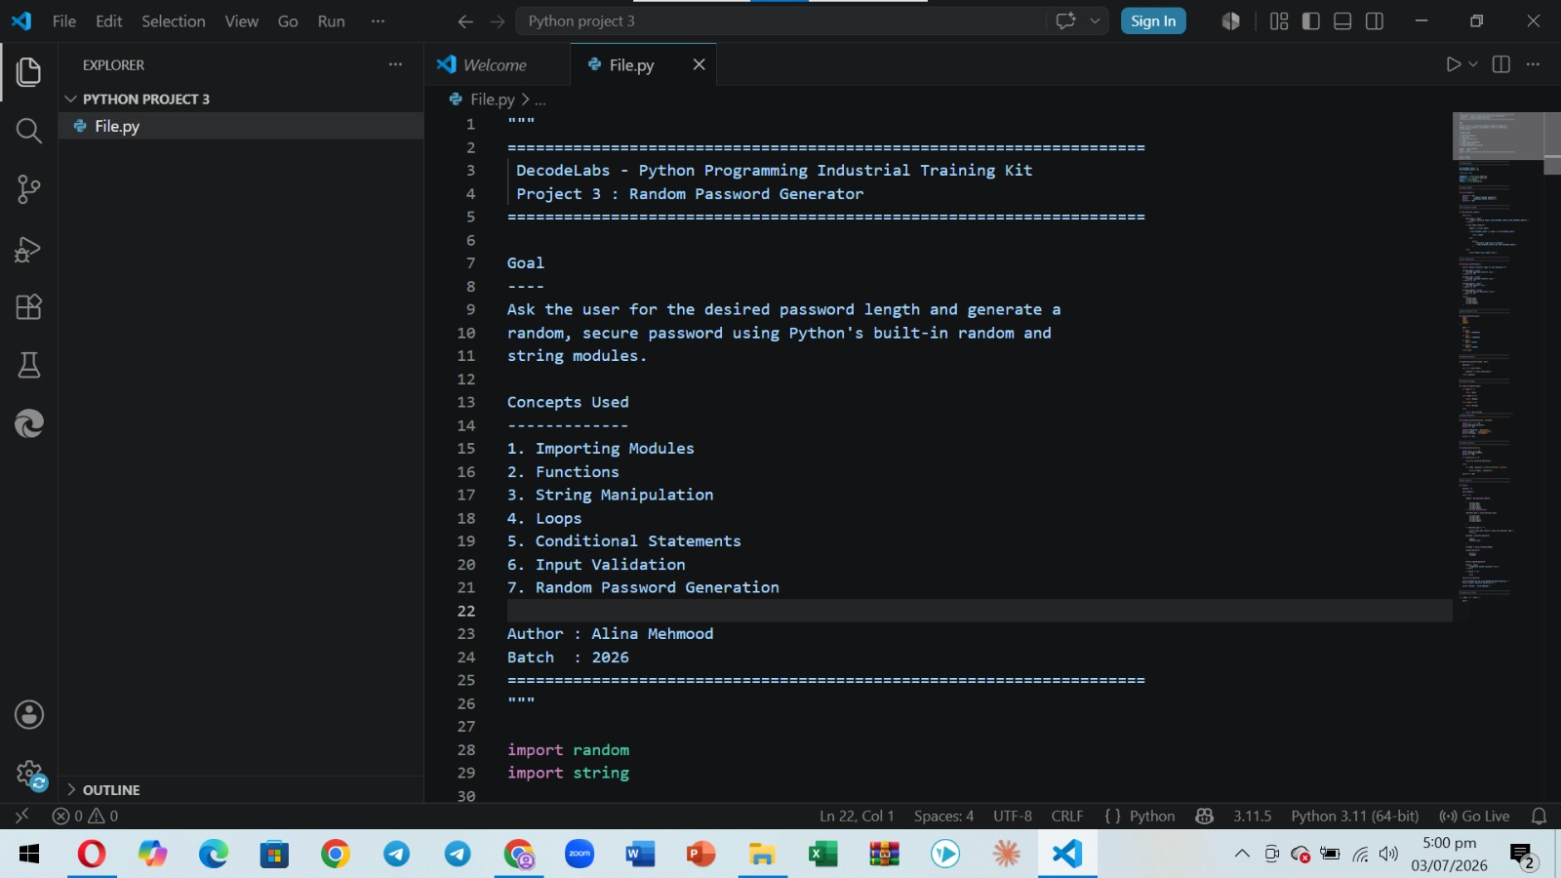

Slide 8
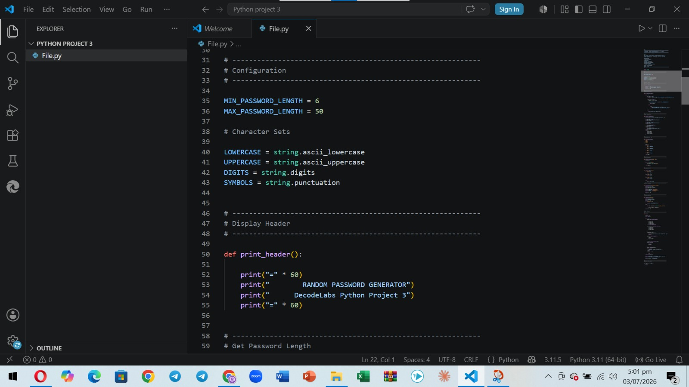

Slide 9
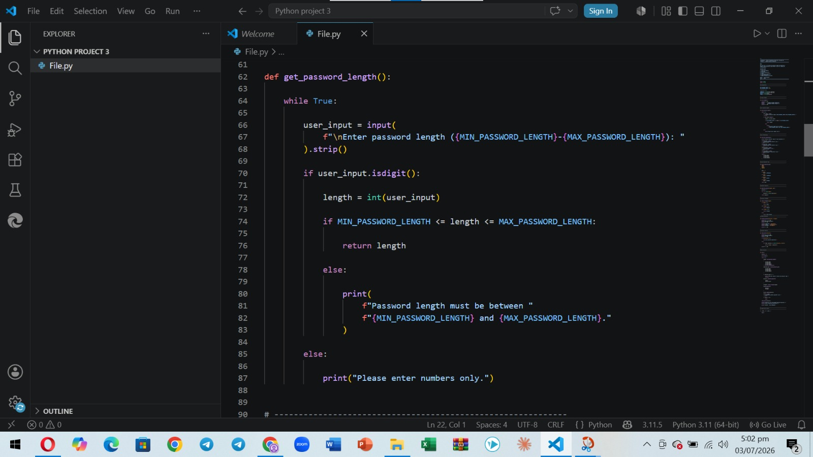

Slide 10
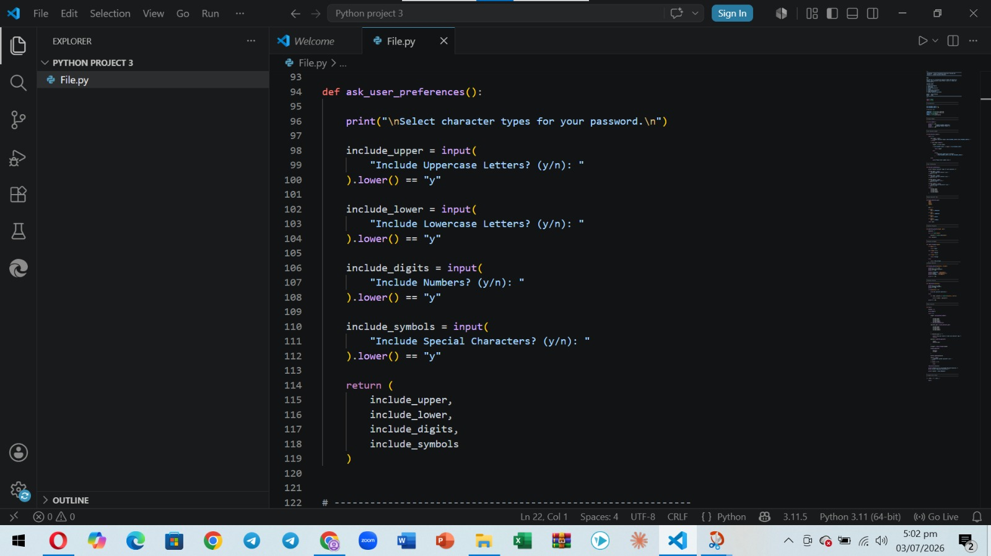

Slide 11
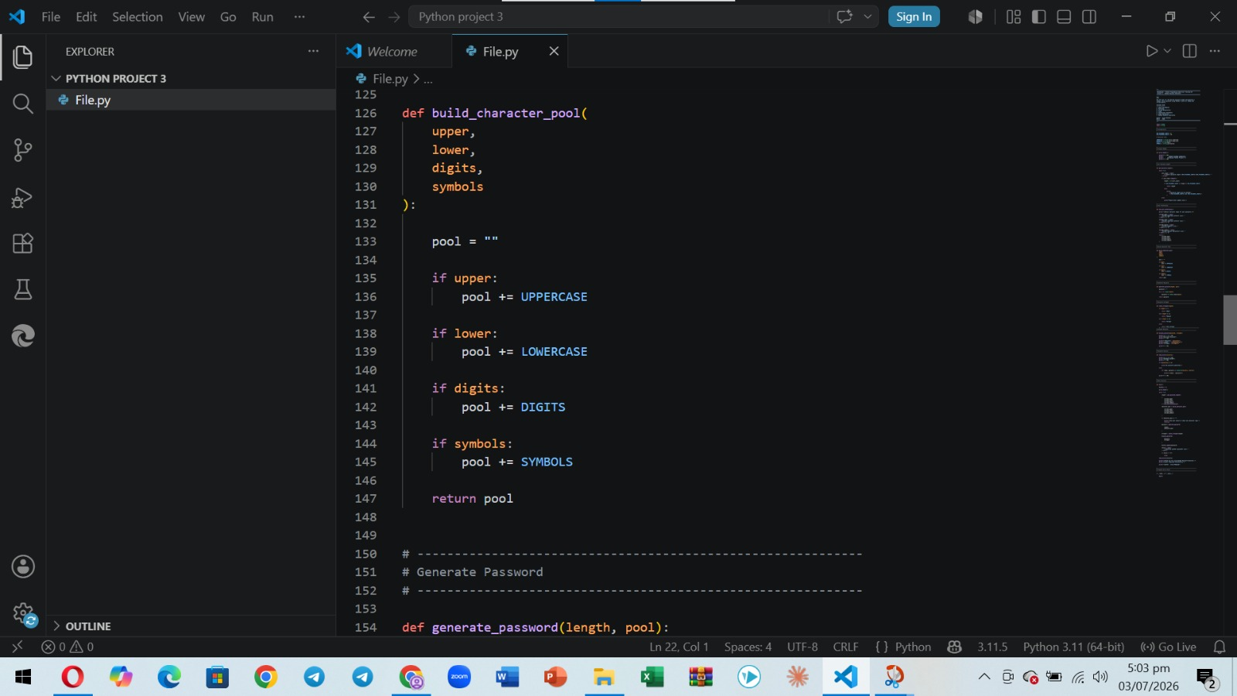

Slide 12
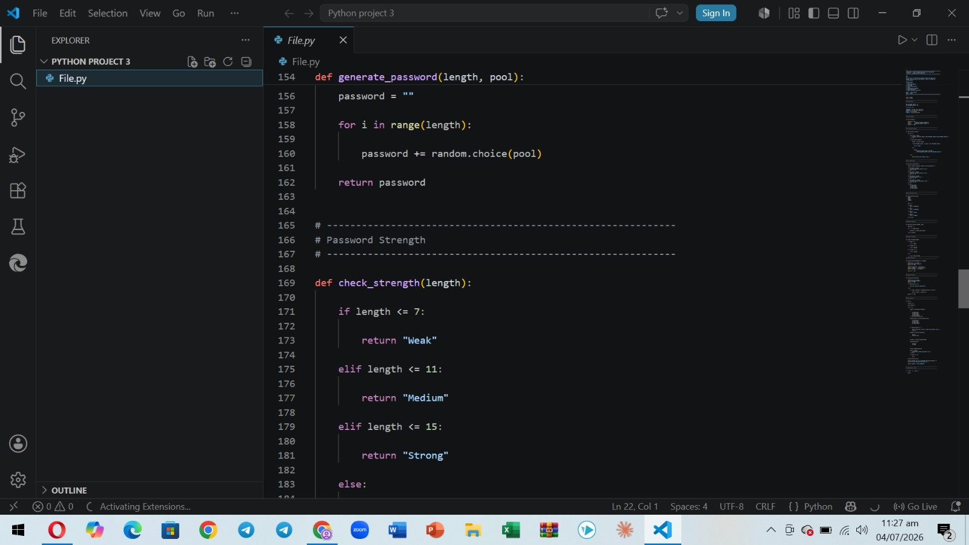

Slide 13
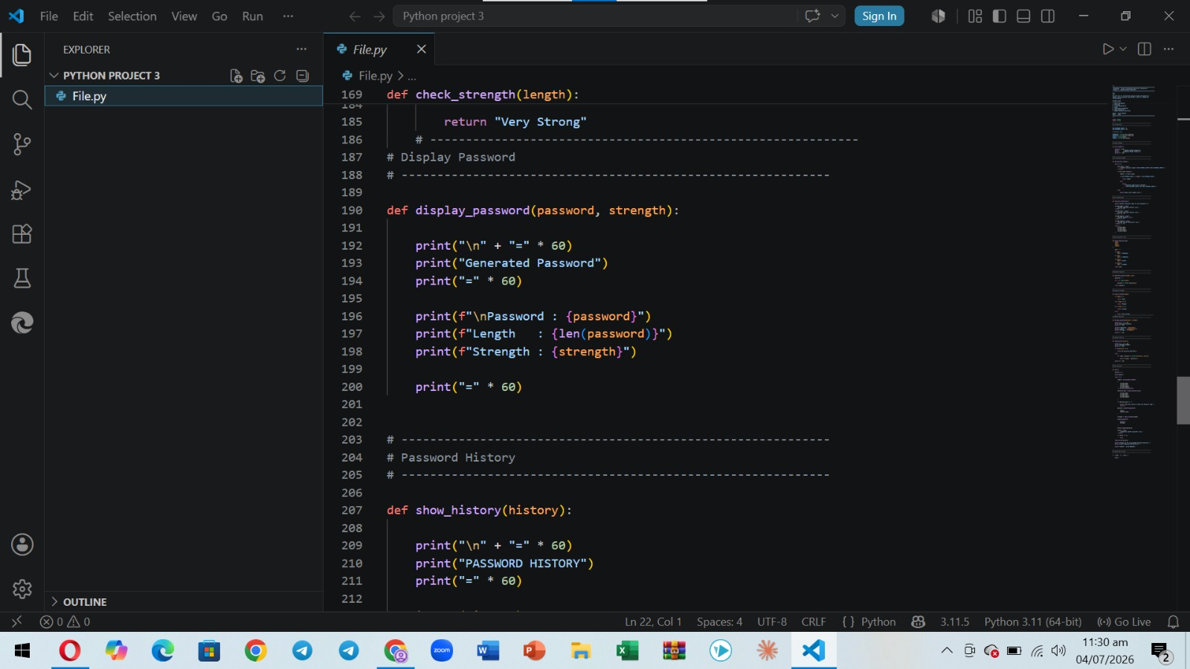

Slide 14
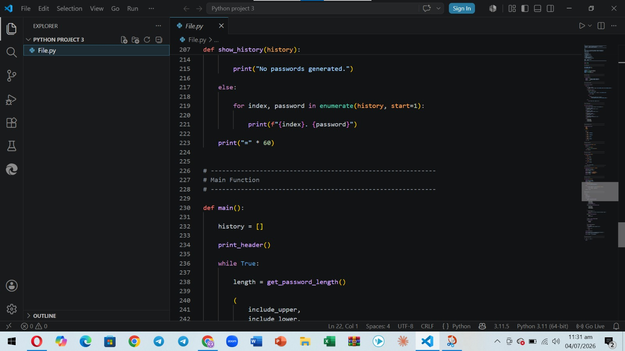

Slide 15
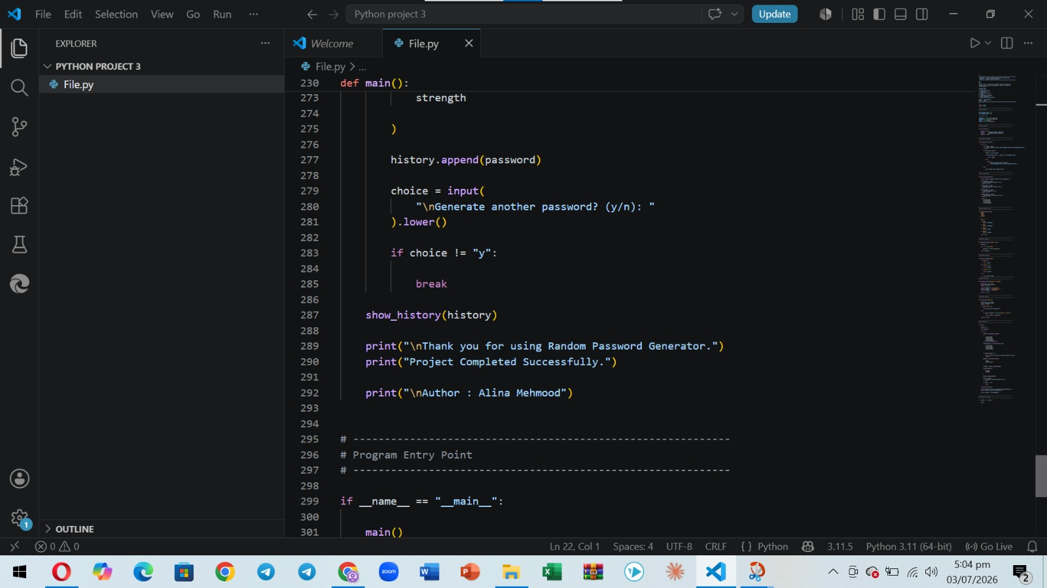

Slide 16

Phase 01
Defining Environmental
Requirements & Validation
A robust implementation must capture a target integer representing the desired password length.
This data must be rigorously validated to prevent system crashes.
Validation also guards against the generation of fundamentally insecure, too-short credentials.
The input phase is the first point of failure in any system.
Validation Checklist
Confirm the input is a whole number, not text
Reject lengths below the secure minimum
Re-prompt gracefully on invalid entries
DecodeLabs | Project 3 | Random Password Generator
7

Slide 17
NIST 2024 Guidelines: Length Over Complexity
Legacy requirements like mandatory uppercase, numbers, and symbols are obsolete — they lead to predictable human patterns.
Legacy Policies | 2024 NIST SP 800-63-4 Updates
Mandatory complexity (1 upper, 1 lower, 1 symbol) | Mandatory Length: minimum of 15 characters required for high-security contexts.
8-character minimum | Maximum Length: systems must allow at least 64 characters to support passphrases.
Periodic 90-day resets | Rotation: periodic resets are eliminated; passwords change only upon compromise.
— | Blocklisting: verifiers must actively screen inputs against known compromised passwords.
DecodeLabs | Project 3 | Random Password Generator
8

Slide 18
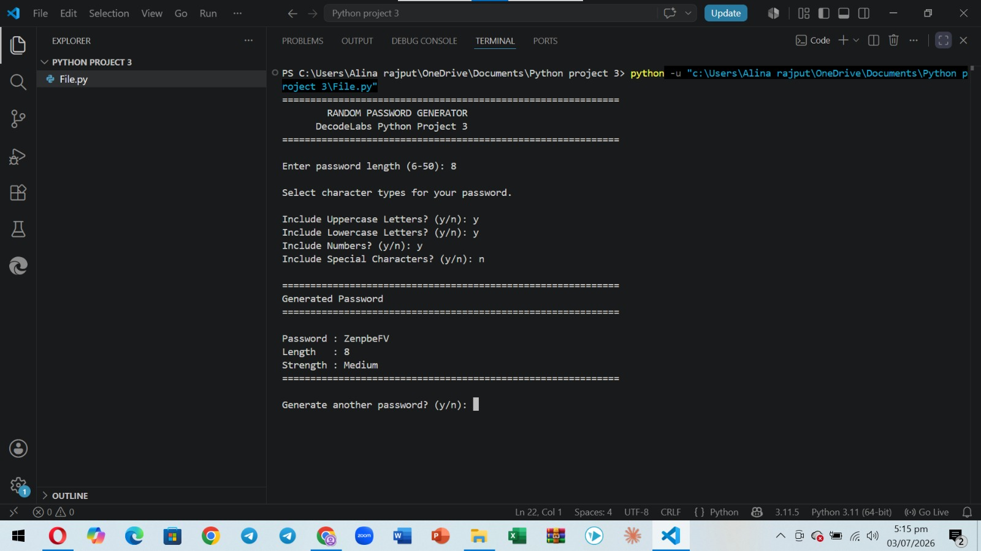

Slide 19
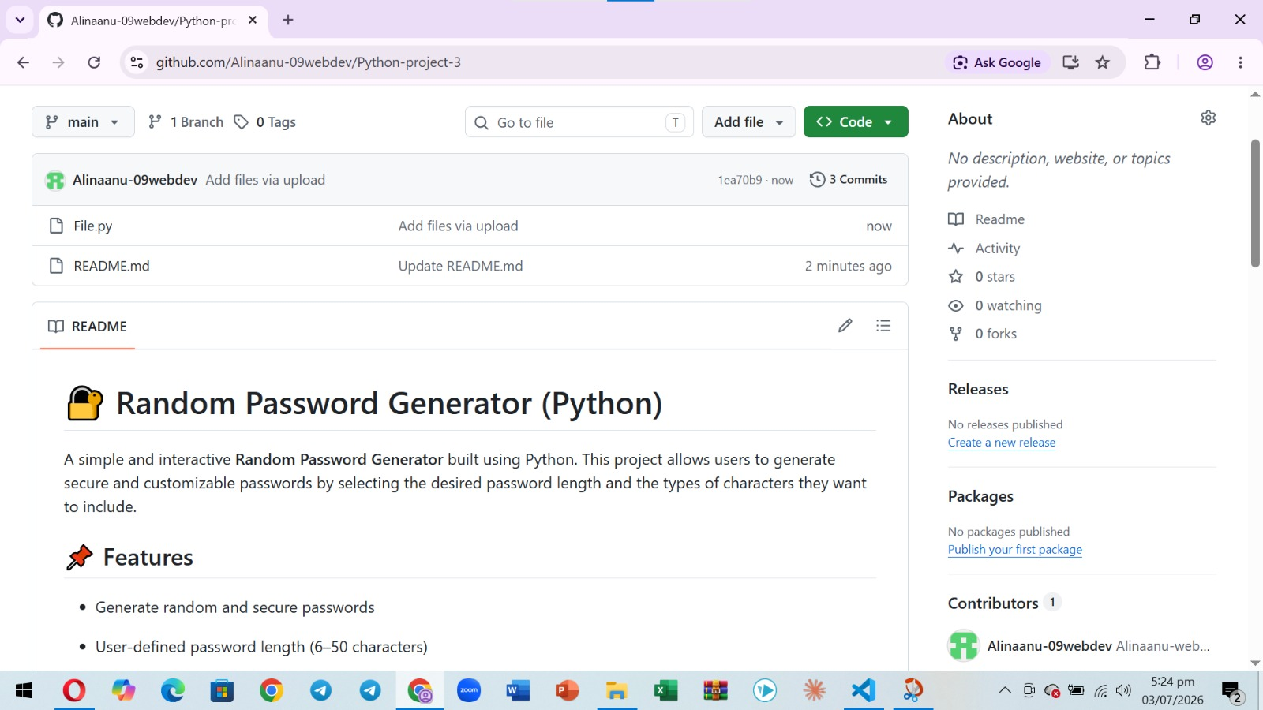

Slide 20
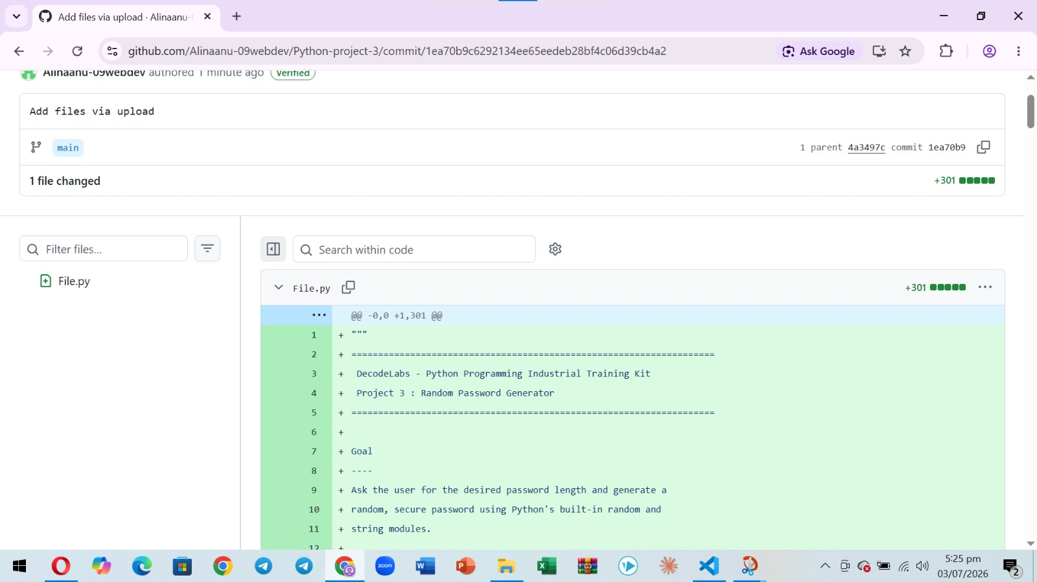

Slide 21

Phase 02: The Backend Transformation Engine
Transitioning from requirement-gathering to the execution of logic — pooling character sets and transforming an integer into a complex, secure string.
Standardizing Character Classification (string module)
Constant | Description
string.ascii_letters | Concatenation of lowercase and uppercase ASCII letters.
string.digits | The string '0123456789'.
string.punctuation | Standard ASCII punctuation and special symbols.
Backend Logic Guarantee
The transformation engine must guarantee both cryptographic integrity and peak memory efficiency at every step.
Manually typing character arrays is tedious, error-prone, and amateur — professional engineers leverage the string module for locale-independent consistency.
DecodeLabs | Project 3 | Random Password Generator
9

Slide 22

Security: random vs. secrets
The deterministic vulnerability of the standard random module.
random module — Not for Security
secrets module — Enterprise Standard
Relies on the Mersenne Twister, a deterministic pseudo-random number generator.
Because it is often seeded by predictable system time, an attacker who knows the seed can calculate and predict the generated password.
Introduced in Python 3.6, secrets is the mandatory enterprise standard for passwords and security tokens.
It taps into the operating system’s highest-quality entropy source (hardware-level noise) via secrets.choice(), replacing random.choice() to ensure outputs are completely unpredictable.
DecodeLabs | Project 3 | Random Password Generator
10

Slide 23
Memory Management: String Immutability
In Python, strings are immutable objects — they cannot be changed in place.
Step 1
Step 2
Step 3
"A"
"A" + "B"
"AB"
Original string object created in memory.
Interpreter attempts modification — fails; original block cannot change.
A completely new object is created; the old one is discarded.
Every time a single character is appended to an existing string, the interpreter copies the old content, adds the new character, and discards the old object — creating significant overhead inside a loop.
DecodeLabs | Project 3 | Random Password Generator
11

Slide 24
Optimizing the Accumulator Pattern
Linear time complexity vs. quadratic time complexity.
The Junior Approach
The Enterprise Approach
password += char
''.join(list)
Creates a temporary object in every iteration, resulting in high memory impact and quadratic time complexity:
Calculates the total required size and performs memory allocation exactly once, achieving highly efficient linear time complexity:
O(N²)
O(N)
Time / memory grows sharply as password length increases.
Time / memory grows proportionally — predictable and efficient.
DecodeLabs | Project 3 | Random Password Generator
12

Slide 25
Phase 03: The Mathematical Provision of Security
Before delivering the randomized string, we must mathematically prove its resistance to modern cracking techniques.
E = L × log₂(R)
Entropy measures the unpredictability of a string, expressed in bits.
L
R
The length of the password.
The size of the character pool (e.g., 62 for alphanumeric).
DecodeLabs | Project 3 | Random Password Generator
13

Slide 26
Modern Hardware Realities Demand Longer Passwords
High-performance GPUs can test billions of combinations per second.
Password Length | Estimated Time to Crack
8 characters (62⁸ complexity) | Cracked in 2 days
10 characters (62¹⁰ complexity) | Cracked in 5 years
16 characters (62¹⁶ complexity) | Secure for millions of years
This mathematical reality is exactly why NIST guidelines now demand length over complexity.
DecodeLabs | Project 3 | Random Password Generator
14

Slide 27
The Validated Architecture of an
Enterprise Backend Engineer
NIST 2024 Inputs
secrets & .join()
Entropy Validation
By mastering the Input-Process-Output scaffold, you have engineered a resilient cybersecurity tool.
Manual arrays were replaced with the string module, O(N²) bottlenecks with .join(), and predictable pseudo-randomness with cryptographically secure secrets.
You are no longer writing isolated scripts — you are ready to architect interconnected APIs in Project 4.
DecodeLabs | Project 3 | Random Password Generator
15

Slide 28
Conclusion
The absolute best way to master Python Programming is through hands-on practice, not just theory.
Take each project one by one, experiment with unique solutions — like allowing special characters (@, #, $) or ensuring the password always contains at least one number — and treat every ModuleNotFoundError or logic error as a learning opportunity.
As you build these milestones at DecodeLabs, you are creating a real-world portfolio that showcases your backend automation skills to future employers.
Your journey to becoming a professional developer begins right here, right now, with the very first secure string you generate today.
DecodeLabs | Project 3 | Random Password Generator
16

Slide 29
Thank You
Presented by Alina Mehmood • Python Developer Track
+91 89330 06408
decodelabs.tech@gmail.com
www.decodelabs.tech
Greater Lucknow, India

